Slide 1


Electric Skateboard
Aritra Chakraborty, Liam Hupfer, Jarvis Jia, Leah Kreiter

Slide 2

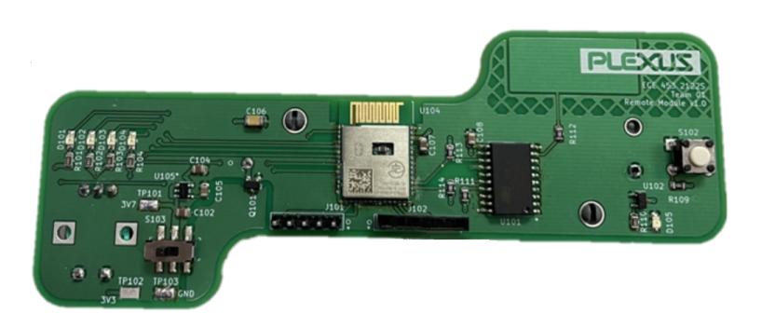
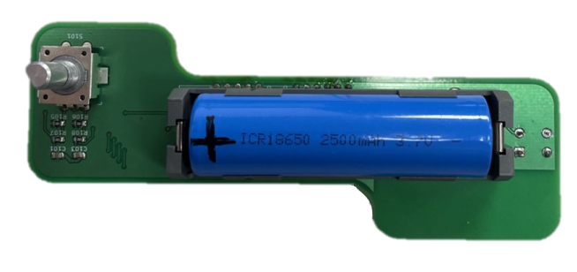
Project Overview
Functional Electric Skateboard with speed controlled by handheld remote
Handheld Remote PCB communicates with PSoc 6 connected to ESC on skateboard
Software designed into FreeRTOS tasks
Notes:
Liam

Slide 3
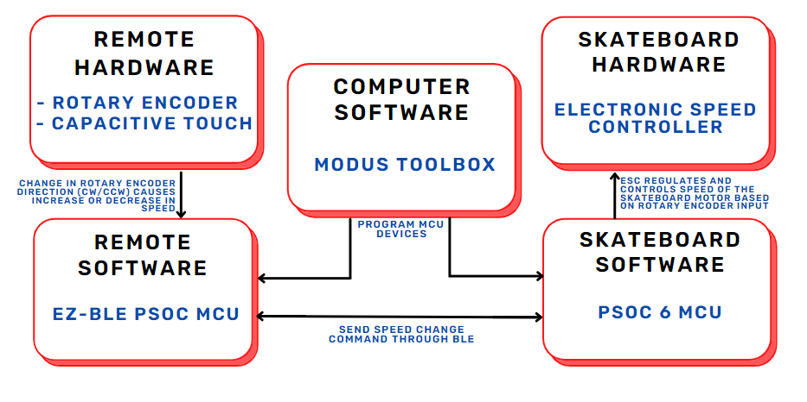
Block Diagram of System Architecture
Notes:
Leah
We start by using a 5 pin programming header to load our computer software, the freeRTOS tasks, onto our remote and skateboard Psoc family MCU devices
Once the computer software has been programmed into our devices, they are ready to use. In order to start using the skateboard, the battery has to be in its holder, and

Slide 4
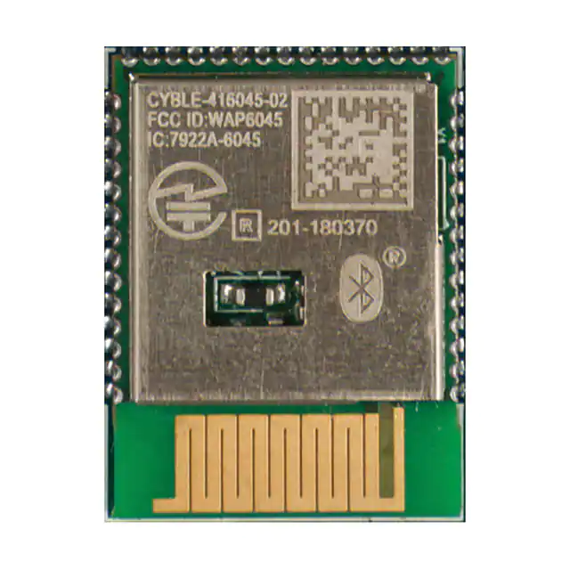
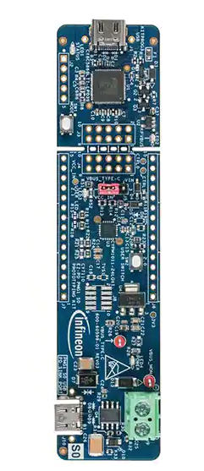
Technical Highlights
BLE communication between two PSoC MCU devices
Set the remote MCU (EZ-BLE PSoC) as the central device
Set the skateboard MCU (PSoC 6) as the peripheral device
Mounting the motor and mechanics to the skateboard
I²C capacitive touch for rider safety
Fine-tuned speed progression using Rotary Encoder
Notes:
Jarvis

Slide 5
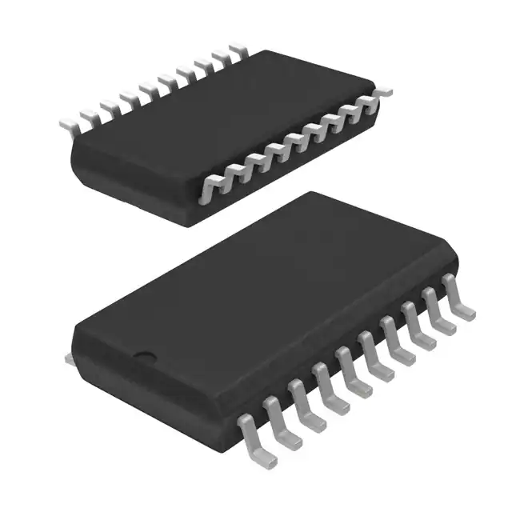
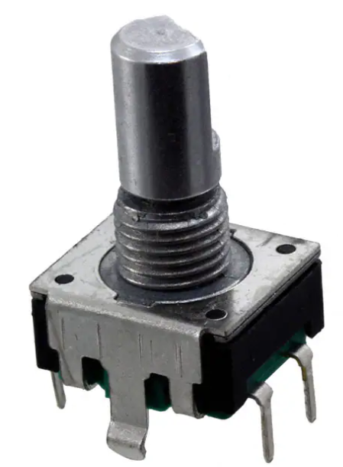
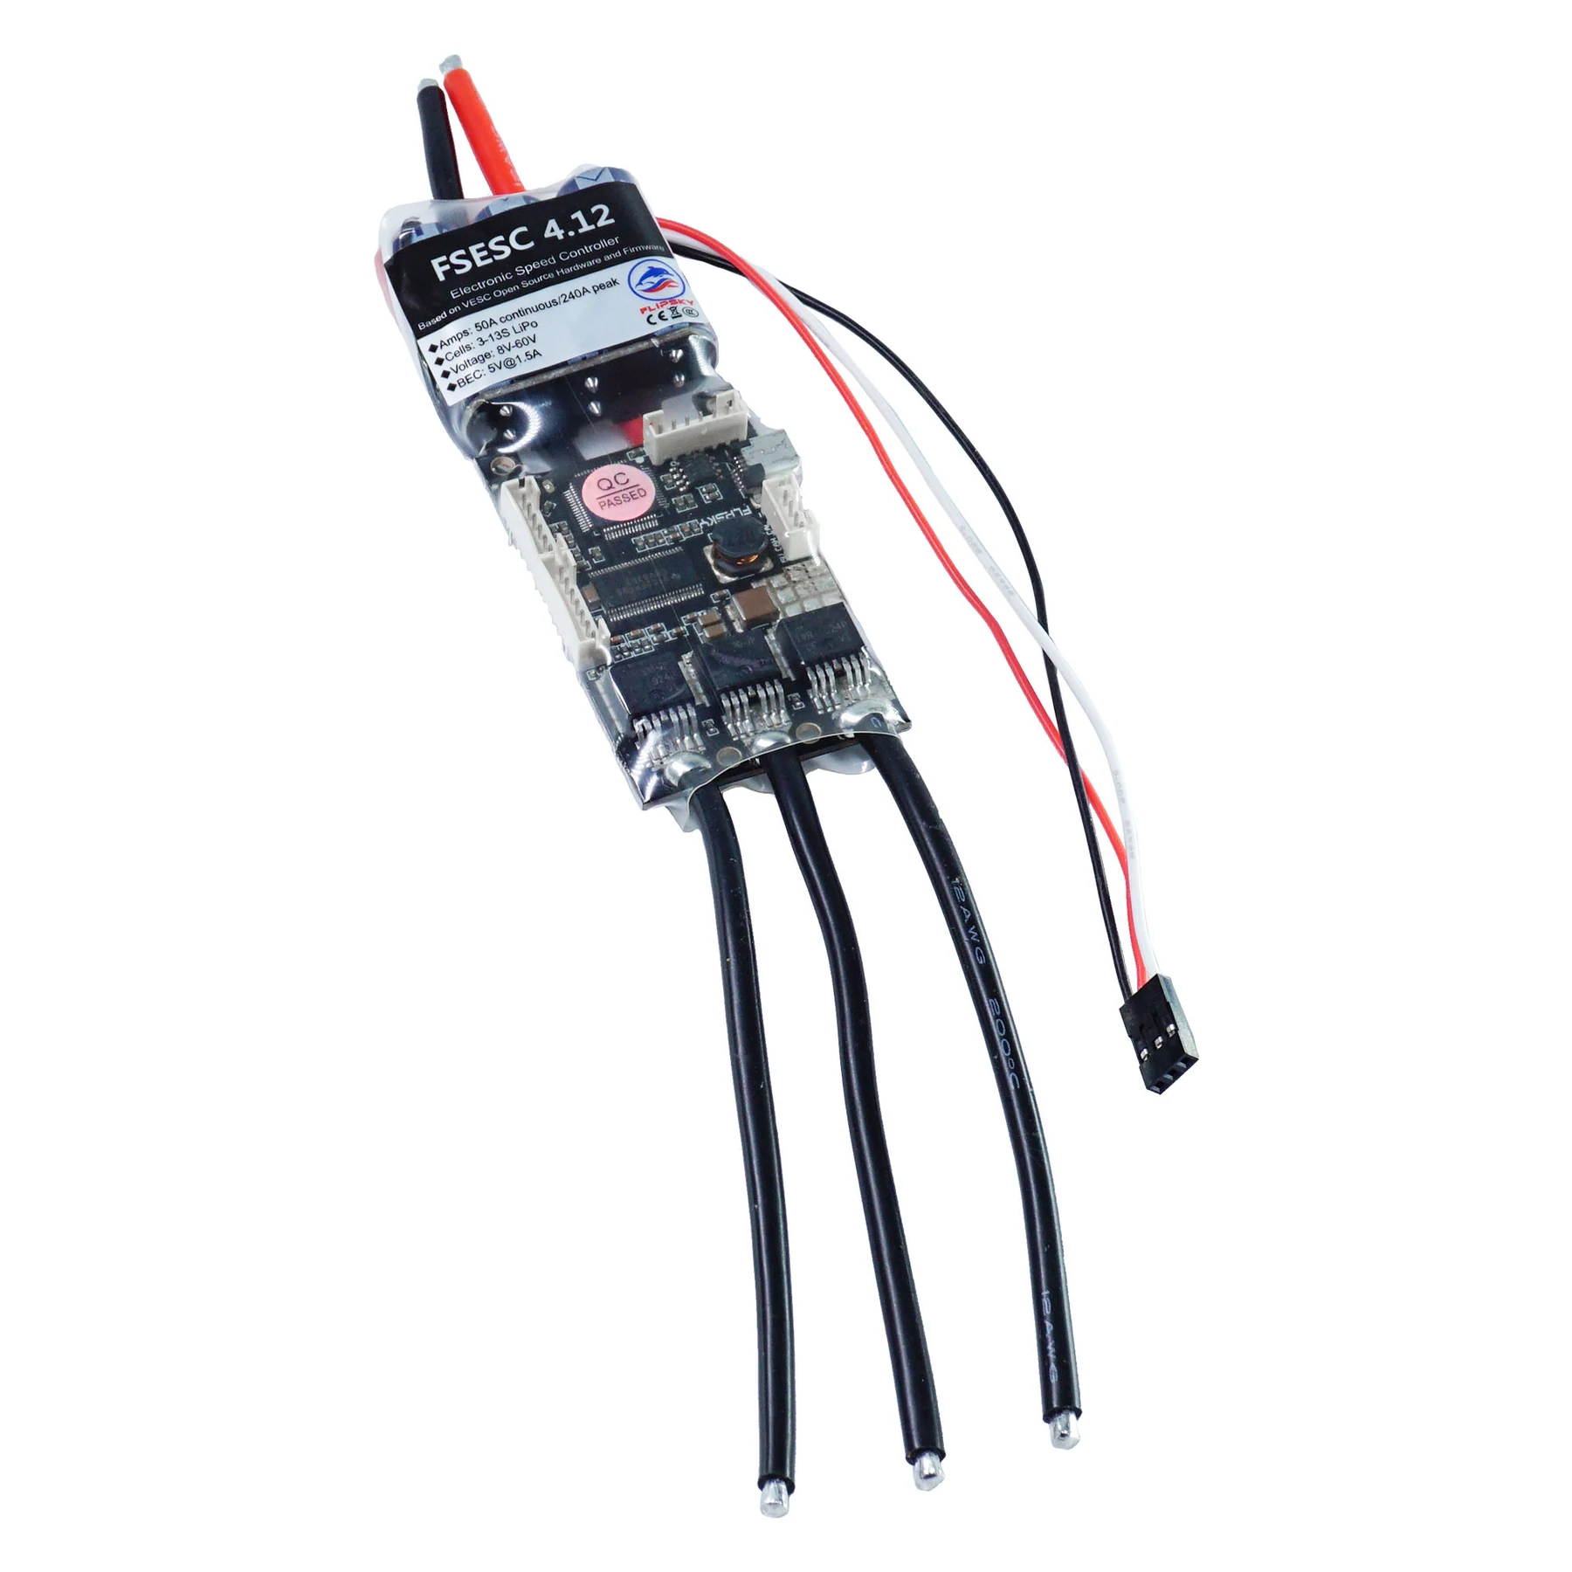
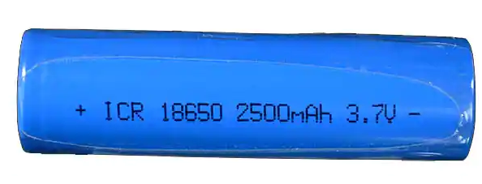
Design Decisions
Handheld remote to control speed
IC capacitive touch to detect rider presence on remote
Rotary encoder used to increase and decrease speed
ESC used to regulate and control electric motor speed
18650 lithium-ion battery to power the remote
Notes:
Leah
Suggested talking points: (???)
Why we chose i2c touch rather than trigger
Why we chose rotary encoder rather than joystick
Why we chose to get a pre-made esc thank making one by scratch
Why we chose to power board with 18650

Slide 6
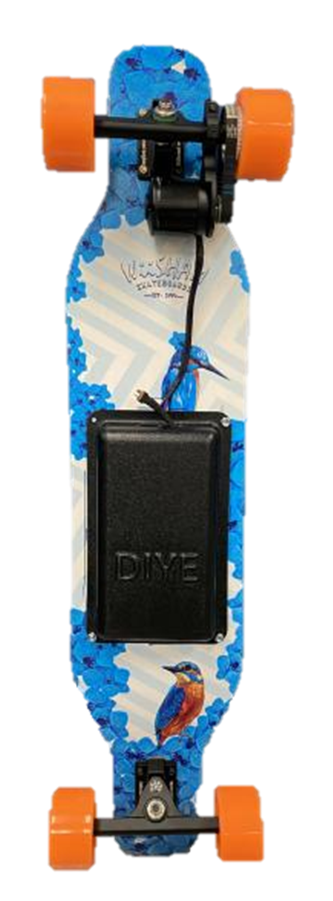
Skateboard Mechanics
10000 mAH battery, 6374 Brushless motor
90mm wheel, 18 teeth motor pulley and 36 teeth wheel pulley
Maximum speed: 28 mph
Distance travelled in one trip: 10 - 12 miles
Notes:
Jarvis

Slide 7


Software Design
Remote Control Module
Rotary Encoder Task
Capacitive Touch Task
Bluetooth Task
Speed LED Task
Skateboard Module
Bluetooth Task
Status LED Task
ESC Task
Notes:
Liam

Slide 8
Overcoming Design Setbacks
Reverse Battery Protection
PCB smoked when the battery was placed in backwards
Rebuilt board testing each component separately
Electronic Speed Controller
Compare different ESCs
Changing PWM setting
Find correct mode to control
Notes:
(Aritra)
Footprint on Kicad had no indication of the positive side of battery, and when we put the battery in the 1043 holder and turned on the power switch on the PCB, it smoked right away. We did not know what part resulted in the short, so we to rebuilt the board and test each component separately by recreating the circuitry on a breadboard and using a DC power supply.
We started testing our ESC with the manufacture’s software, but it only tested at one speed. It was a long process to discover how to change the PWM signal. We used UART to debug and realized the mode of ESC was incorrect. Once we were in the correct mode, we had to convert the PWM ints to floats for a gradual linear increase in speed.

Slide 9
Overcoming Design Setbacks
Rotary Encoder
‘Quadrature Decoder’ code from the Hardware Abstraction Layer (HAL) on Modus Toolbox was not working with the pins on the MCU
Not ideal for one-handed use for rider
I²C Capacitive Touch
Original PCB design did not include change status indication pin
Notes:
(Aritra)
Two of our setbacks were incorrectly routing the PCB so the Hardware Abstraction Layer on Modus Toolbox wouldn’t work. At first, we tried to solve this issue manually. Using the waveform given by the rotary encoder schematics, we polled the signs and decided the direction of the encoder, clockwise or counterclockwise. It was difficult to determine when to poll and decoding the waveforms accurately, so we re-routed the PCB to use the correct pins and the given QD code worked perfectly. This was the same case for the I2C and re-routing the board was the best course of action. As for the remote’s user friendliness, the encoder was difficult to turn in the manner we wanted to and would require two hands to operate. We fixed this by 3D printing an enclosure that allows the user to turn the rotary encoder easily with their thumb.

Slide 10

Video Demonstration

